Slide 1
Identity Collage
Thesis Statements and your Written Component

Slide 2

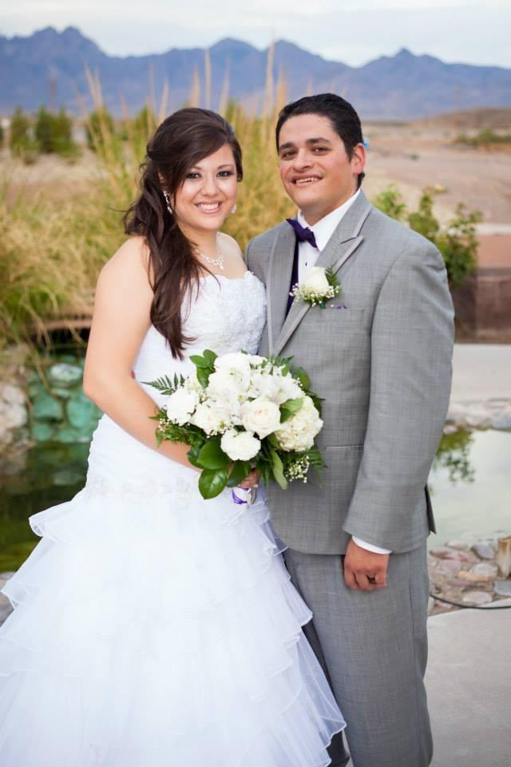






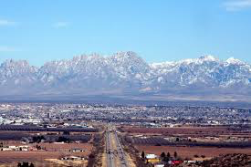
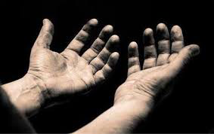







My identity collage

Slide 3
My example:
The purpose of identities are to show how people choose to be perceived because they unearth our own perceptions about the world and reveal a personal history about why we are the way we are.

Slide 4
YOUR THESIS:
Stem #1:
Identities are important because ____________ and __________________.
Stem #2:
The purpose of an identity is to ____________ because it _____________ and _____________.
Stem #3:
Identities reveal _______________ about people because they _____________ and ______________.
----------------------------------------------------------------
→ Your thesis MUST be written in a complete sentence.
→ Ensure that you have 2 reasons in your statement.
→ Thesis should address the topic of identity in general (it should relate to anyone).
Choose ONE of the sentence stems provided to create YOUR thesis statement. Follow the guidelines provided. You MUST have your thesis statement approved by the end of the class period. Make sure Mrs. Mendoza initials it TODAY. You may not write the rest of your written component until your thesis statement has been approved.

Slide 5
Written Component
Paragraph #1 = Reason #1 (from your thesis)
How do you personally connect to that reason?
How does the pictures you used prove that reason?
Choose 1 or 2 specific pictures and explain how they reveal [Reason #1] about YOU.
Paragraph #2 = Reason #2 (from your thesis)
How do you personally connect to that reason?
How does the pictures you used prove that reason?
Choose 1 or 2 specific pictures and explain how they reveal [Reason #2] about YOU.

Slide 6
My example:
Paragraph #1
A person’s very existence in the world is dependent upon multiple factors that make an impression on how they view it. Personally, my life experiences have not been easy. Instead of becoming bitter about all of the things that don’t go my way, I have learned to become fearless yet humble in how I approach difficult situations. For example, in my collage I included pictures of my children from when my youngest was in the hospital for 32 unbearable days with an illness that was unknown and could have cost her life. That experience revealed my true character because even though I felt like giving up and was frustrated that I could not help my child, I remained hopeful that she would be healed and grateful for the overwhelming support we received from doctors, coworkers, friends, etc. In addition, my collage includes pictures of a quote about feminism and an icon of the college I have my first degree from. What most people don’t know about me is that I was the ONLY female in my family to graduate from college and now pursue a Master’s Degree. I chose to become an educator in order to be able to inspire other kids with similar stories that no matter what challenges they face, it is best to tackle them and persevere. Finally, these photos show that despite the circumstances that are beyond my control, the way I cope is to face them head on while remaining respectful and observant because my attitude affects those around me. It is my belief that my upbringing and choices I have made in my journey have lead me to develop a perspective in which I face the world.

