Slide 1


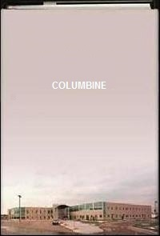
Question: How do we implement learned strategies, through mentor texts, in our writing?
Five Senses: Touch Taste Smell Hear Sight | Mastering Short Sentences: The use of minimal words to make a maximum point in writing. | Figurative Language: Personification: Objects possess human qualities
Mentor Activity: Partners: Use the five senses to describe a setting | Mentor Texts: Day One Disaster? E. Bogdany Columbine Dave Cullen | Mentor Texts: I AM MALALA Chapter 2

